Slide 1
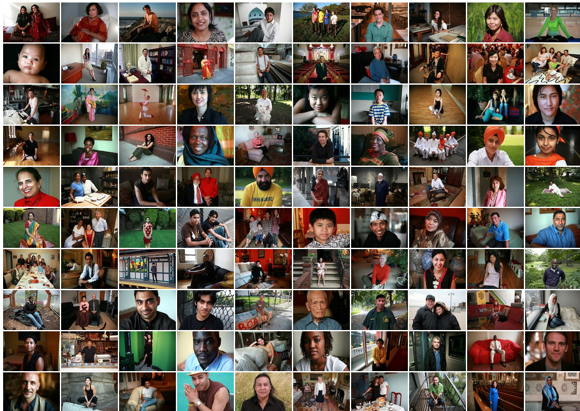
If the world were 100 People
http://www.100people.org/
http://blog.visual.ly/the-psychology-of-percentages/

Slide 2
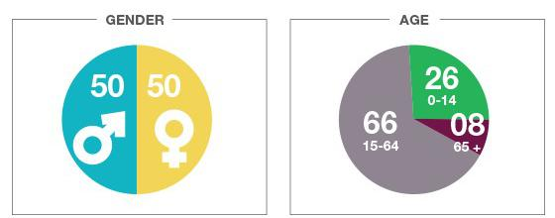
If the world were 100 People

Slide 3
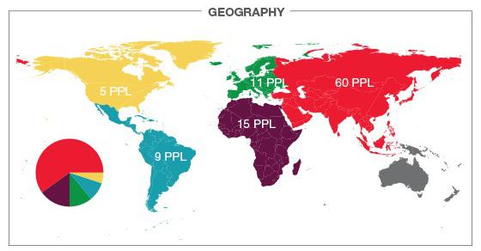
If the world were 100 People
Where People Live

Slide 4
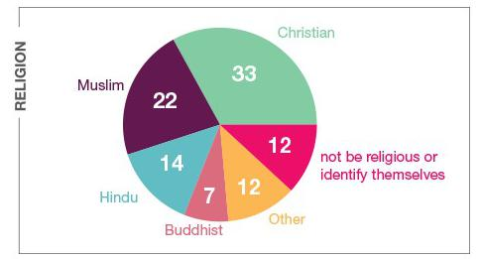
If the world were 100 People

Slide 5
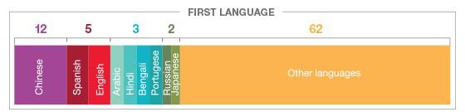
If the world were 100 People

Slide 6

If the world were 100 People

Slide 7
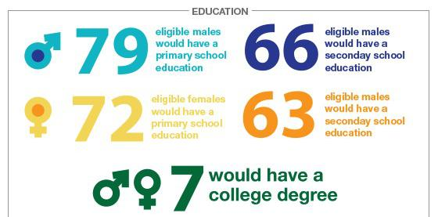
If the world were 100 People

Slide 8
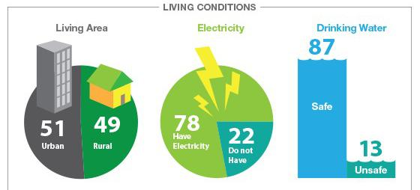
If the world were 100 People

Slide 9
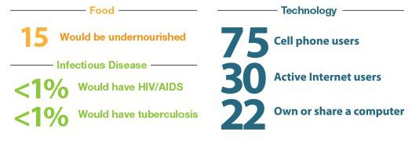
If the world were 100 People

Slide 10

If the world were 100 People
Wealth Inequality in the USA

